Slide 1

Chapter 11:
Artificial Intelligence
Computer Science: An Overview
Tenth Edition
by
J. Glenn Brookshear

Slide 2
Chapter 11: Artificial Intelligence
11.1 Intelligence and Machines
11.2 Perception
11.3 Reasoning
11.4 Additional Areas of Research
11.5 Artificial Neural Networks
11.6 Robotics
11.7 Considering the Consequences

Slide 3
Intelligent Agents
Agent: A “device” that responds to stimuli from its environment
  Sensors
  Actuators
Much of the research in artificial intelligence can be viewed in the context of building agents that behave intelligently

Slide 4
Levels of Intelligent Behavior
Reflex: actions are predetermined responses to the input data
More intelligent behavior requires knowledge of the environment and involves such activities as:
  Goal seeking
  Learning

Slide 5
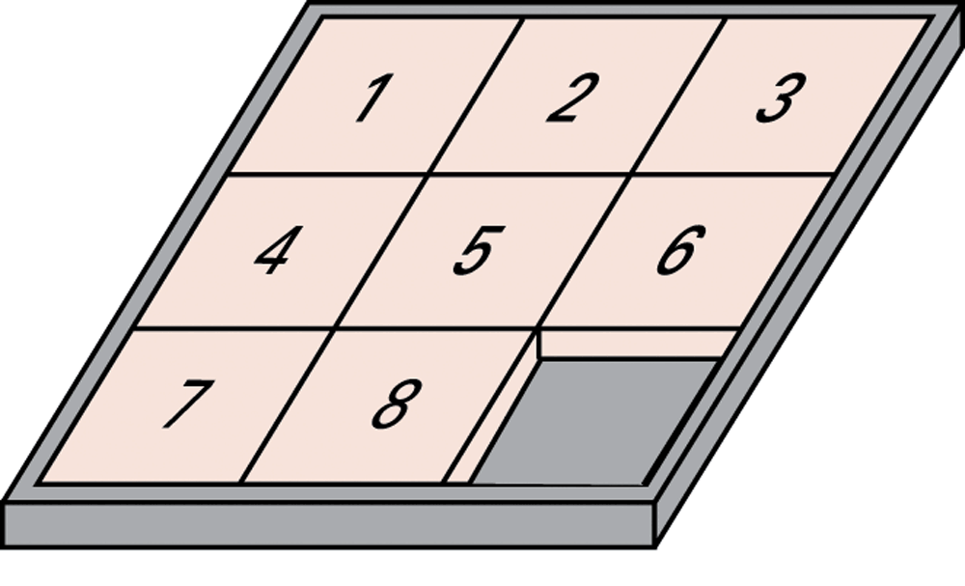
Figure 11.1 The eight-puzzle in its solved configuration

Slide 6
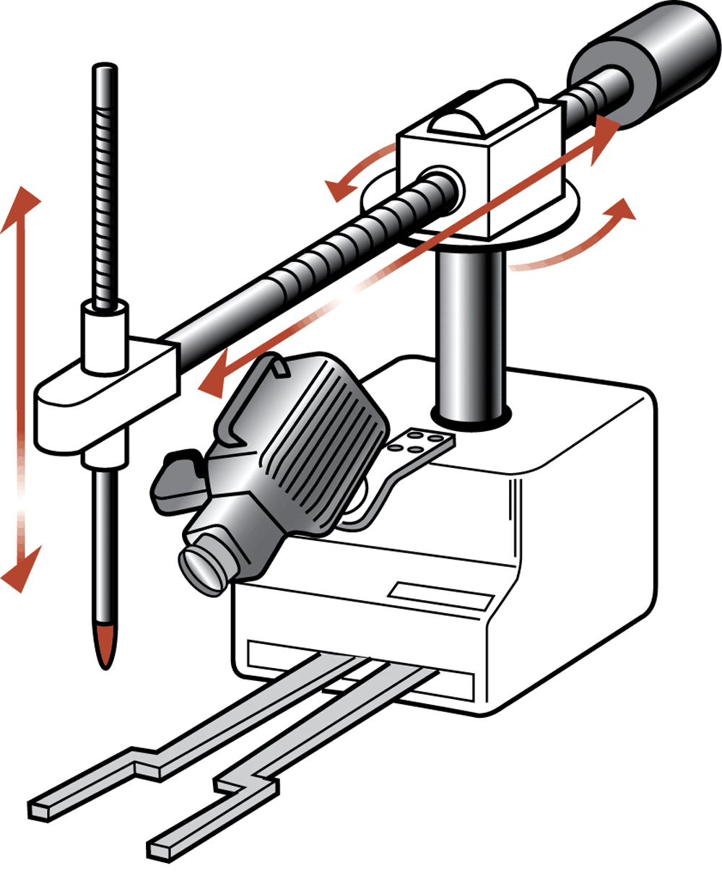
Figure 11.2 Our puzzle-solving machine

Slide 7
Approaches to Research in Artificial Intelligence
Engineering track
  Performance oriented
Theoretical track
  Simulation oriented

Slide 8
Turing Test
Test setup: Human interrogator communicates with test subject by typewriter.
Test: Can the human interrogator distinguish whether the test subject is human or machine?

Slide 9
Techniques for Understanding Images
Template matching
Image processing
  edge enhancement
  region finding
  smoothing
Image analysis

Slide 10
Language Processing
Syntactic Analysis
Semantic Analysis
Contextual Analysis

Slide 11
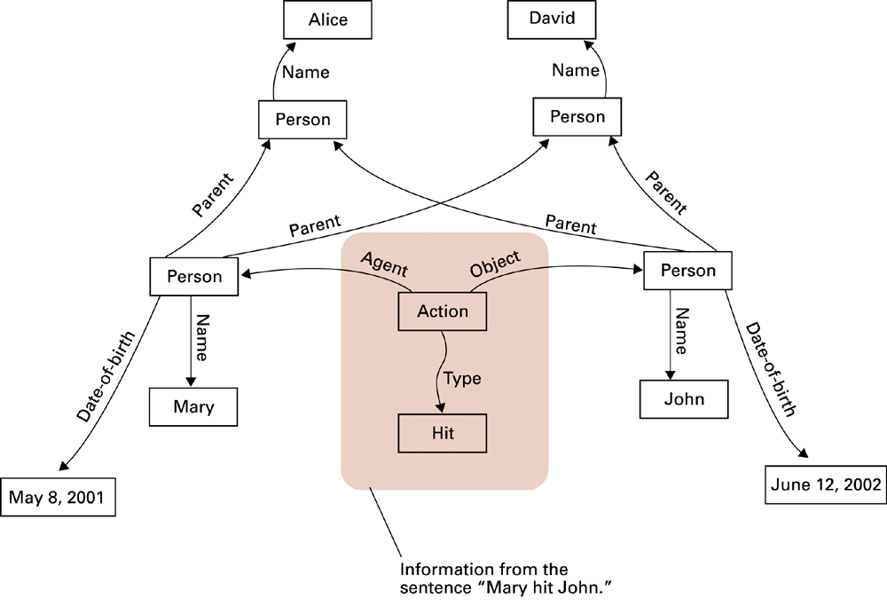
Figure 11.3 A semantic net

Slide 12
Components of a Production Systems
1. Collection of states
  Start (or initial) state
  Goal state (or states)
2. Collection of productions: rules or moves
  Each production may have preconditions
3. Control system: decides which production to apply next

Slide 13
Reasoning by Searching
State Graph: All states and productions
Search Tree: A record of state transitions explored while searching for a goal state
  Breadth-first search
  Depth-first search

Slide 14
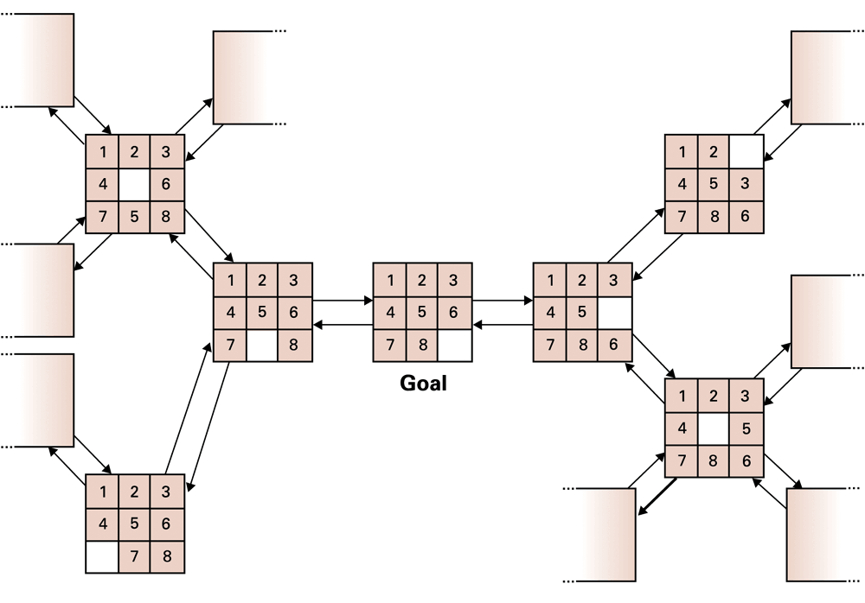
Figure 11.4 A small portion of the eight-puzzle’s state graph

Slide 15
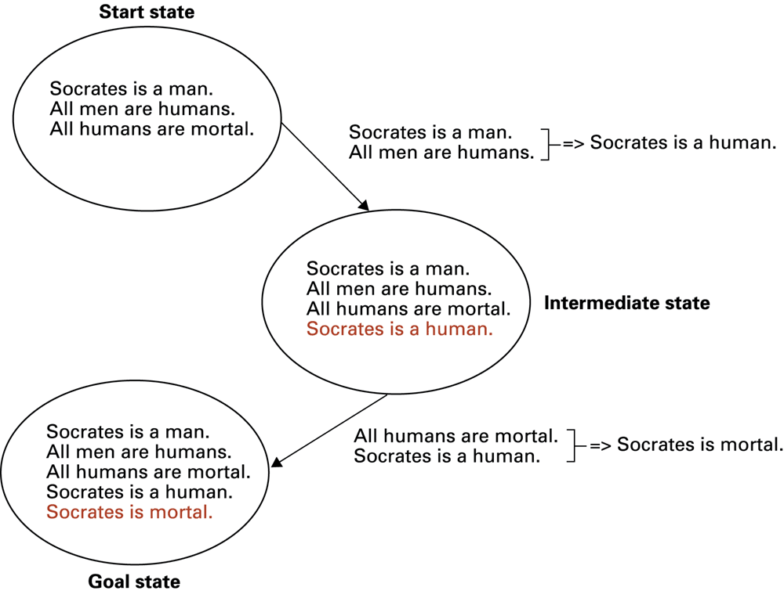
Figure 11.5 Deductive reasoning in the context of a production system

Slide 16
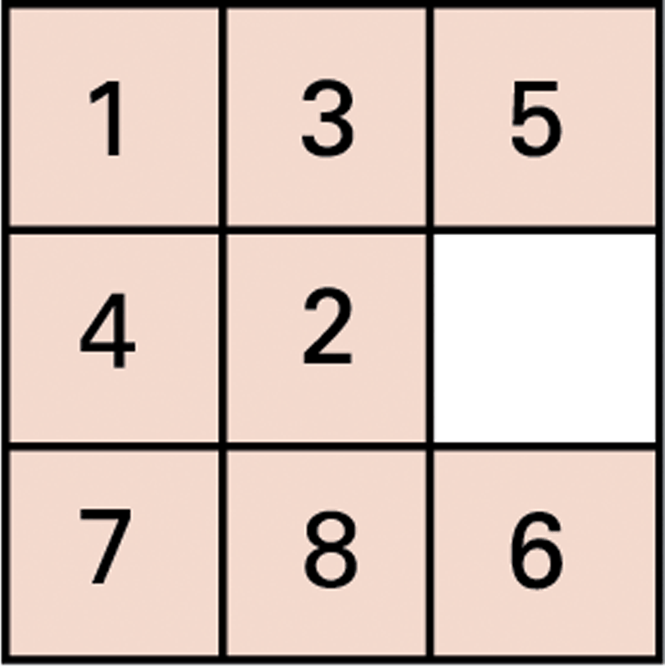
Figure 11.6 An unsolved eight-puzzle

Slide 17
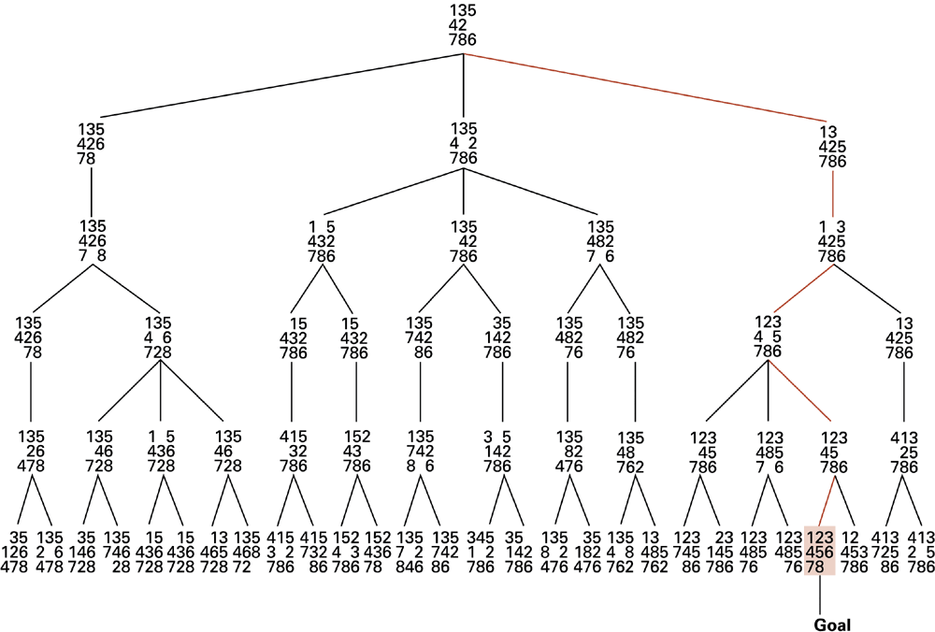
Figure 11.7 A sample search tree

Slide 18
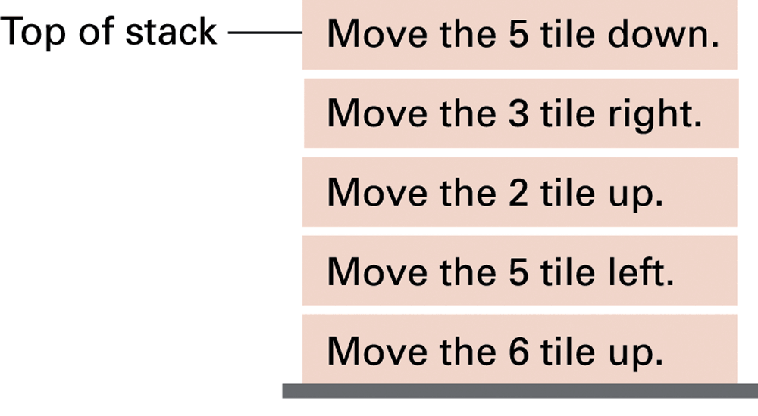
Figure 11.8 Productions stacked for later execution

Slide 19
Heuristic Strategies
Heuristic: A “rule of thumb” for making decisions
Requirements for good heuristics
  Must be easier to compute than a complete solution
  Must provide a reasonable estimate of proximity to a goal

Slide 20
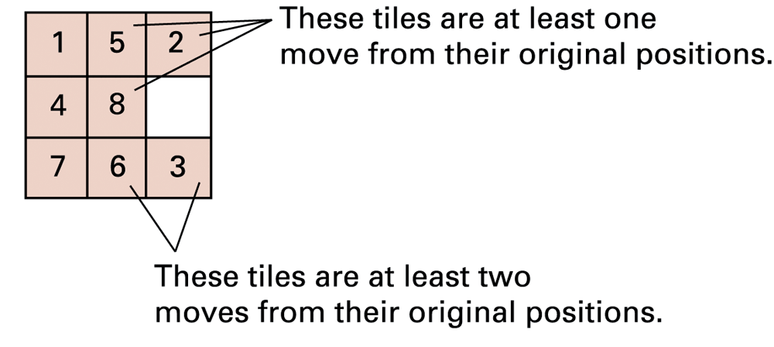
Figure 11.9 An unsolved eight-puzzle

Slide 21
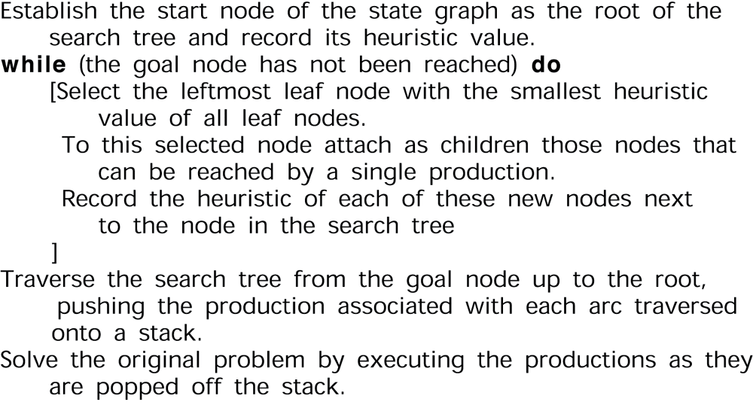
Figure 11.10 An algorithm for a control system using heuristics

Slide 22
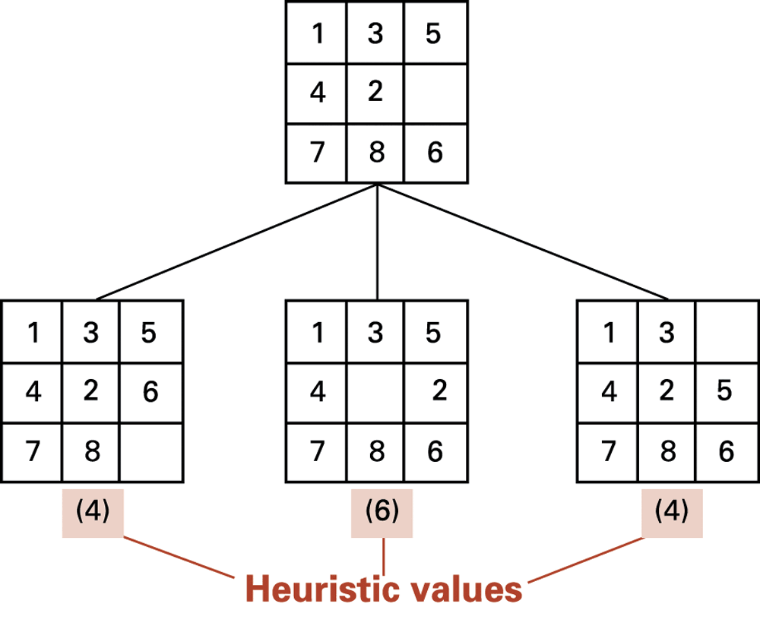
Figure 11.11 The beginnings of our heuristic search

Slide 23
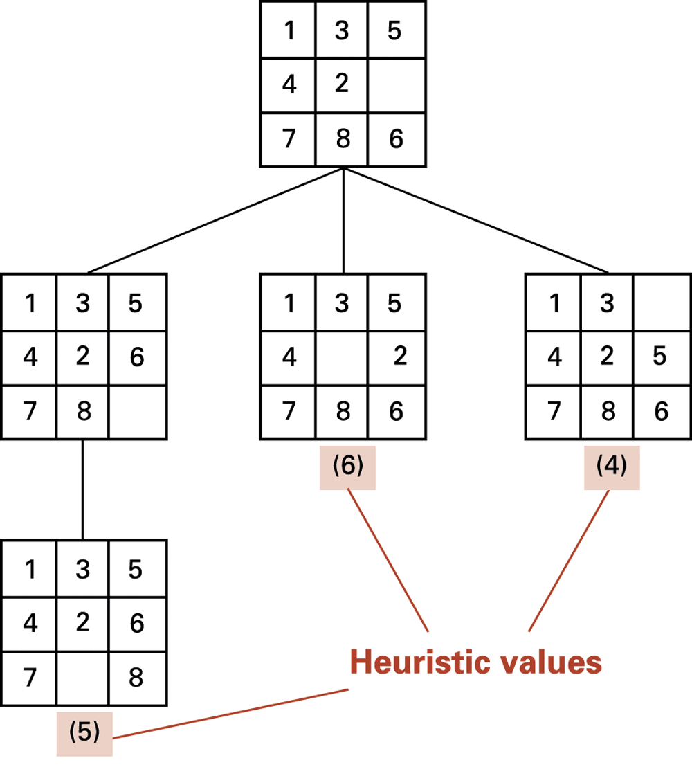
Figure 11.12 The search tree after two passes

Slide 24
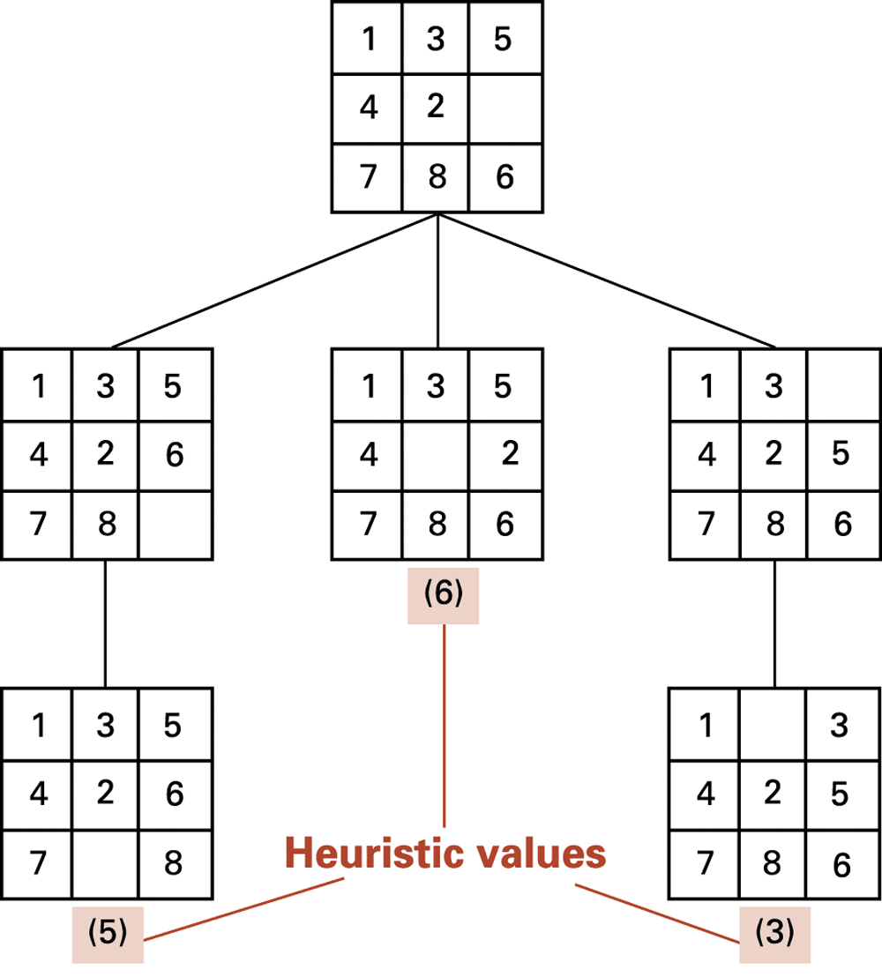
Figure 11.13 The search tree after three passes

Slide 25
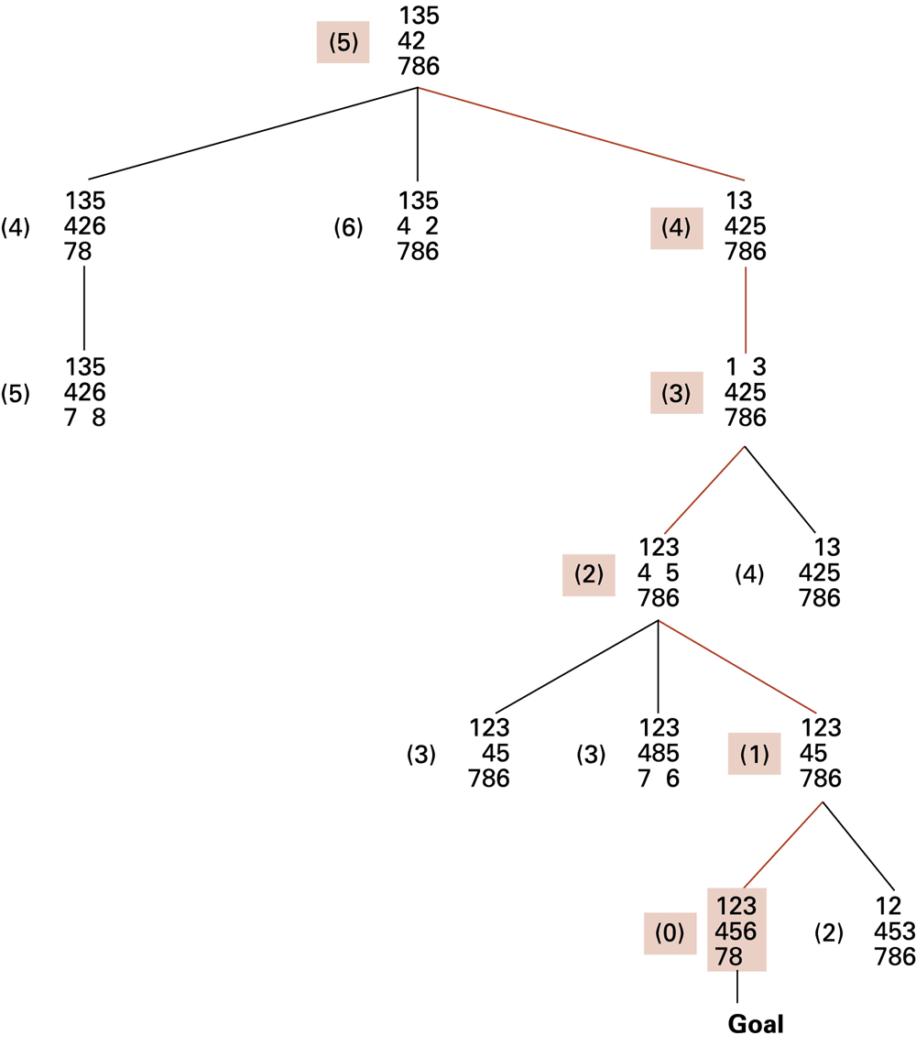
Figure 11.14 The complete search tree formed by our heuristic system

Slide 26
Handling Real-World Knowledge
Representation and storage
Accessing relevant information
  Meta-Reasoning
  Closed-World Assumption
Frame problem

Slide 27
Learning
Imitation
Supervised Training
Reinforcement
Evolutionary Techniques

Slide 28
Artificial Neural Networks
Artificial Neuron
  Each input is multiplied by a weighting factor.
  Output is 1 if sum of weighted inputs exceeds the threshold value; 0 otherwise.
Network is programmed by adjusting weights using feedback from examples.

Slide 29
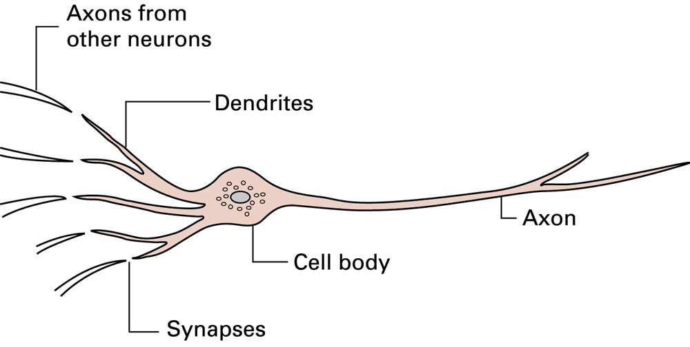
Figure 11.15 A neuron in a living biological system

Slide 30
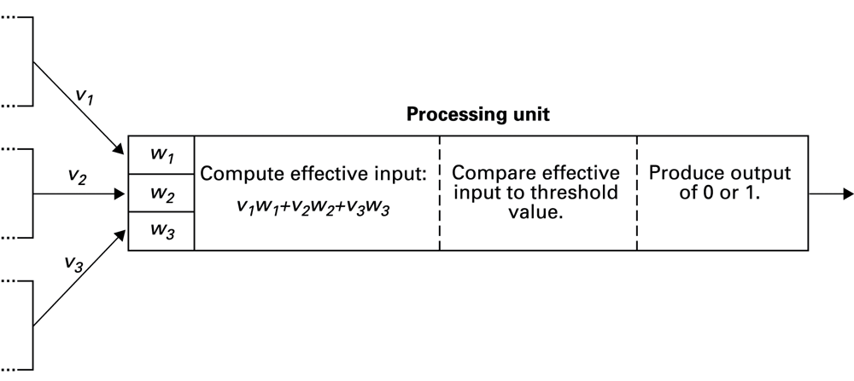
Figure 11.16 The activities within a processing unit

Slide 31
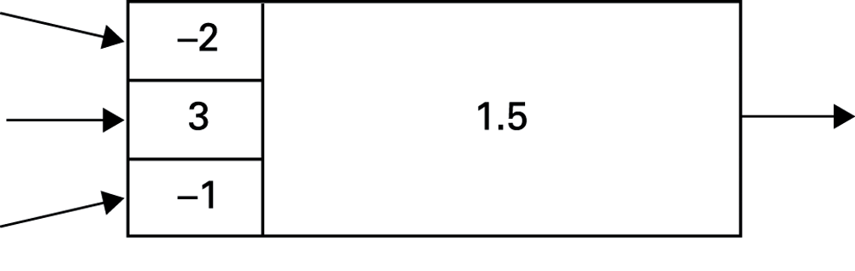
Figure 11.17 Representation of a processing unit

Slide 32
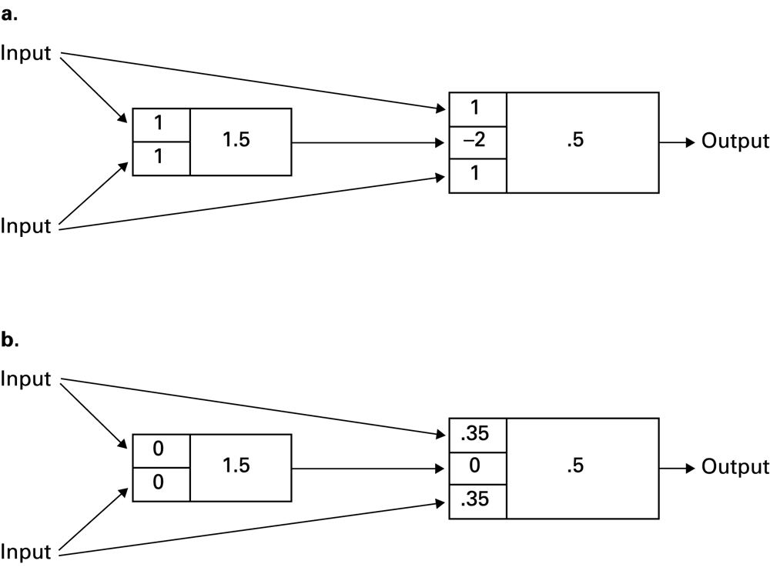
Figure 11.18 A neural network with two different programs

Slide 33
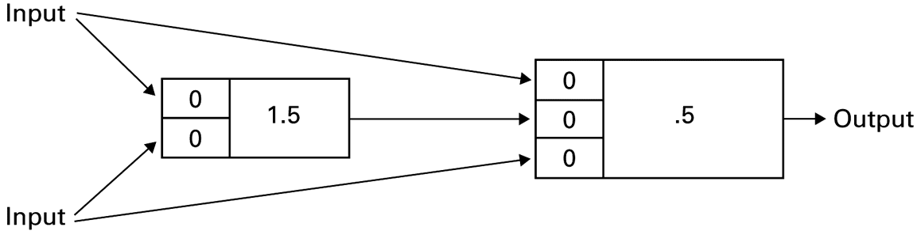
Figure 11.19 An artificial neural network

Slide 34
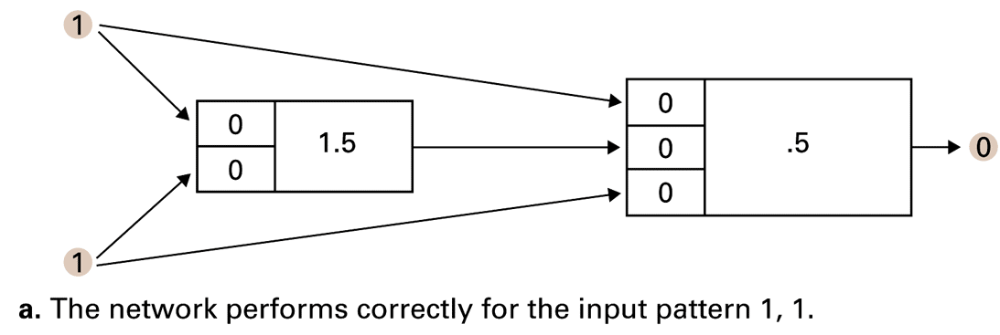
Figure 11.20 Training an artificial neural network

Slide 35
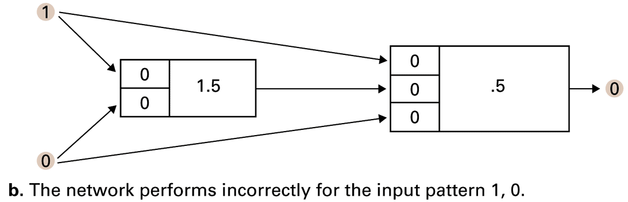
Figure 11.20 Training an artificial neural network (continued)

Slide 36
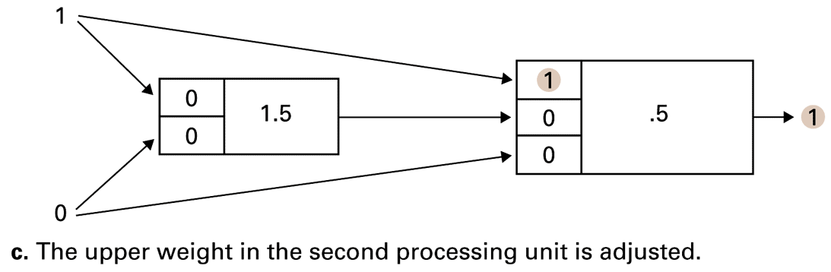
Figure 11.20 Training an artificial neural network (continued)

Slide 37
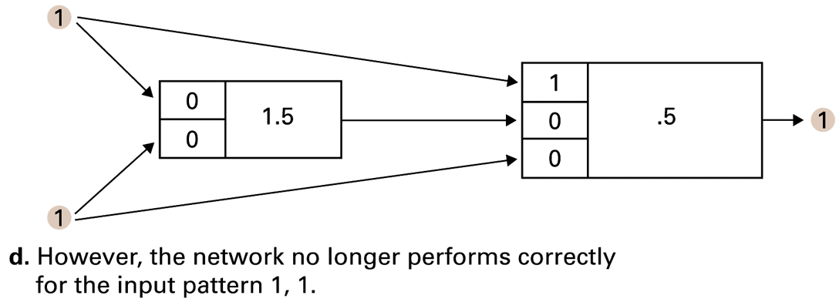
Figure 11.20 Training an artificial neural network (continued)

Slide 38
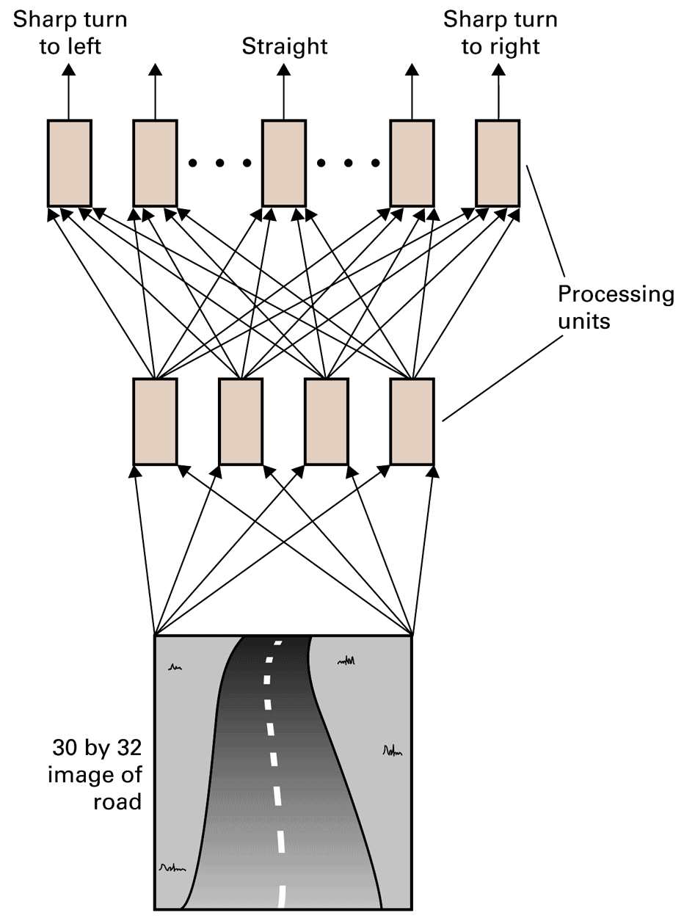
Figure 11.21 The structure of ALVINN

Slide 39
Associative Memory
Associative memory: The retrieval of information relevant to the information at hand
One direction of research seeks to build associative memory using neural networks that when given a partial pattern, transition themselves to a completed pattern.

Slide 40
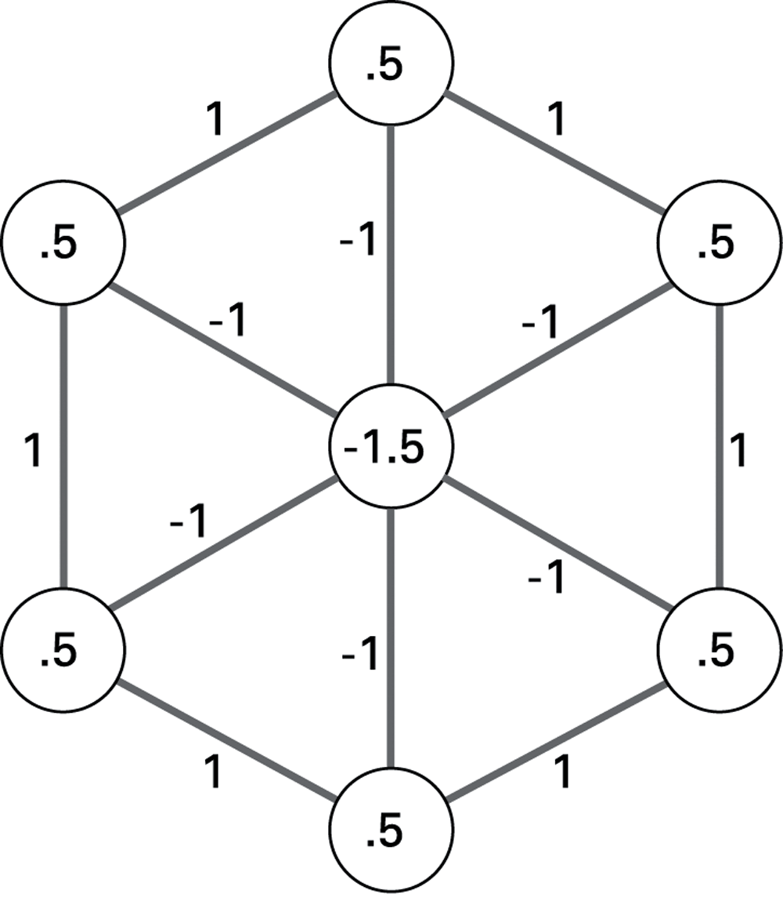
Figure 11.22 An artificial neural network implementing an associative memory

Slide 41
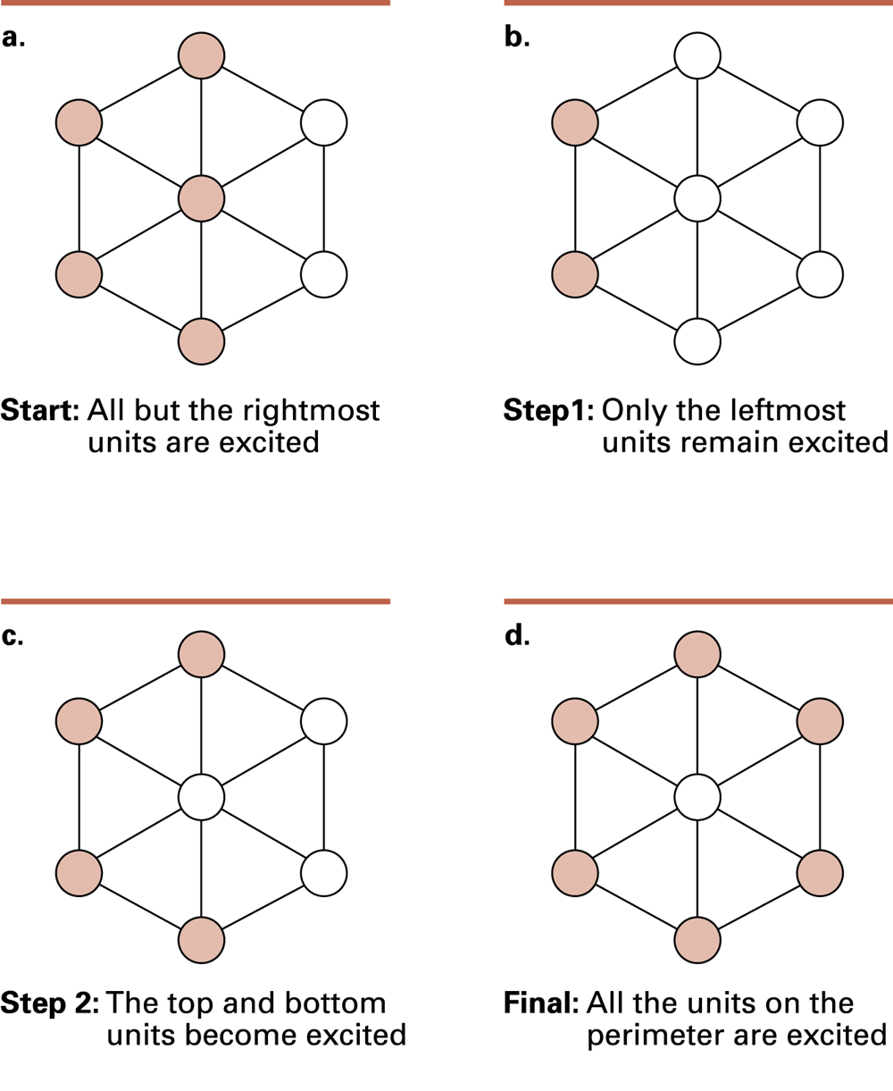
Figure 11.23 The steps leading to a stable configuration

Slide 42
Robotics
Truly autonomous robots require progress in perception and reasoning.
Major advances being made in mobility
Plan development versus reactive responses
Evolutionary robotics

Slide 43
Issues Raised by Artificial Intelligence
When should a computer’s decision be trusted over a human’s?
If a computer can do a job better than a human, when should a human do the job anyway?
What would be the social impact if computer “intelligence” surpasses that of many humans?

